Slide 1

University Messaging System
Team Name : Panda
Team member : Naveen

Slide 2

University Messaging System
University Messaging System is a web-based communication system designed to help students and faculty to communicate with each other and with a group.
Users who require access to the system should be registering on the registration page. The request shall be forwarded to the Administrator for the final decision.
Approved users shall be able to login to the system, send, view and receive messages.

Slide 3
What changed since midterm
Initial mockup screens were developed using paint and now html pages development completed.
Analysis and Design is completed.
Most of the code is completed.
Front-end to backed interaction is completed.

Slide 4
Change Management
Training
This is a browser-based application and people can be trained over skype or zoom meeting.Users can access the application during the training and register for access. The respective requests will be approved and they shall be able to login to the application. Application documentation with help screenshots shall be available for them for reference.
Integration
The application code which is developed as part of this project is an open-ended and it flexible and open for modifications. As most of the technologies used in the project are open source and can be integrated with any other applications or software without any issues.As a next step webservices shall be developed and exposed so that other applications in the ecosystem can consume them.
Issues
Any issues discovered will be logged into JIRA and each issue would be assigned with a priority level like ‘critical’, ‘major’ and ‘minor’.As next step feedback from Users shall be taken and depending on their requirement the issues with highest priority shall be fixed followed by low priority ones.

Slide 5
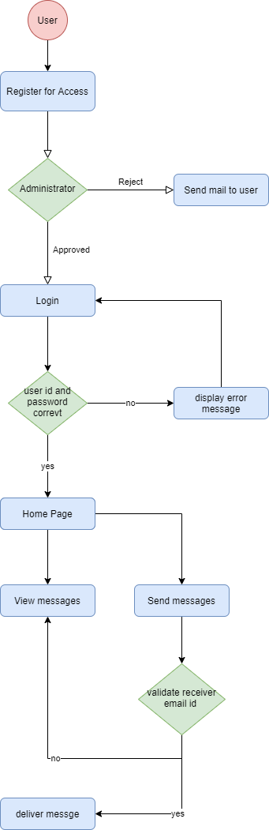
Activity Diagram

Slide 6
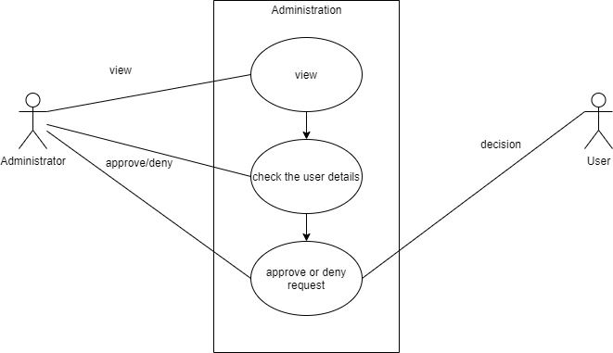
Use Case diagram Administration

Slide 7
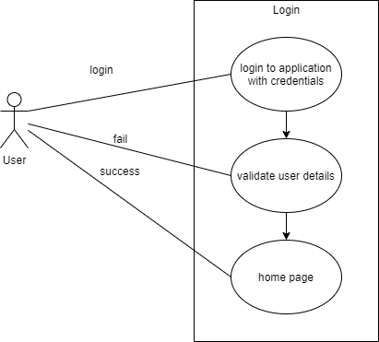
Use Case diagram Login

Slide 8
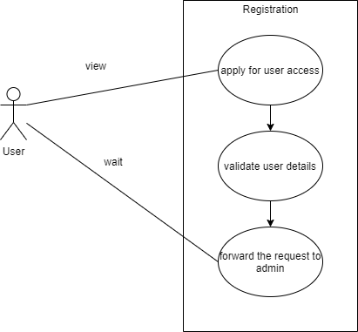
Use Case diagram Registration

Slide 9
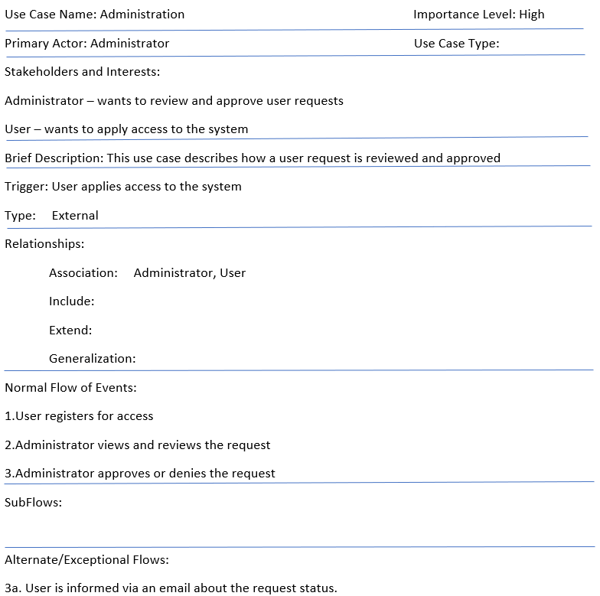

Use Case Description

Slide 10
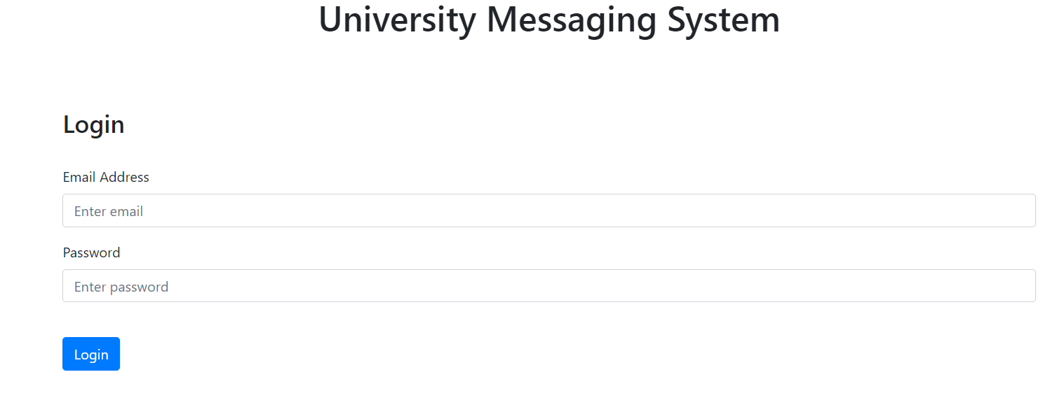
Login screen from the application

Slide 11
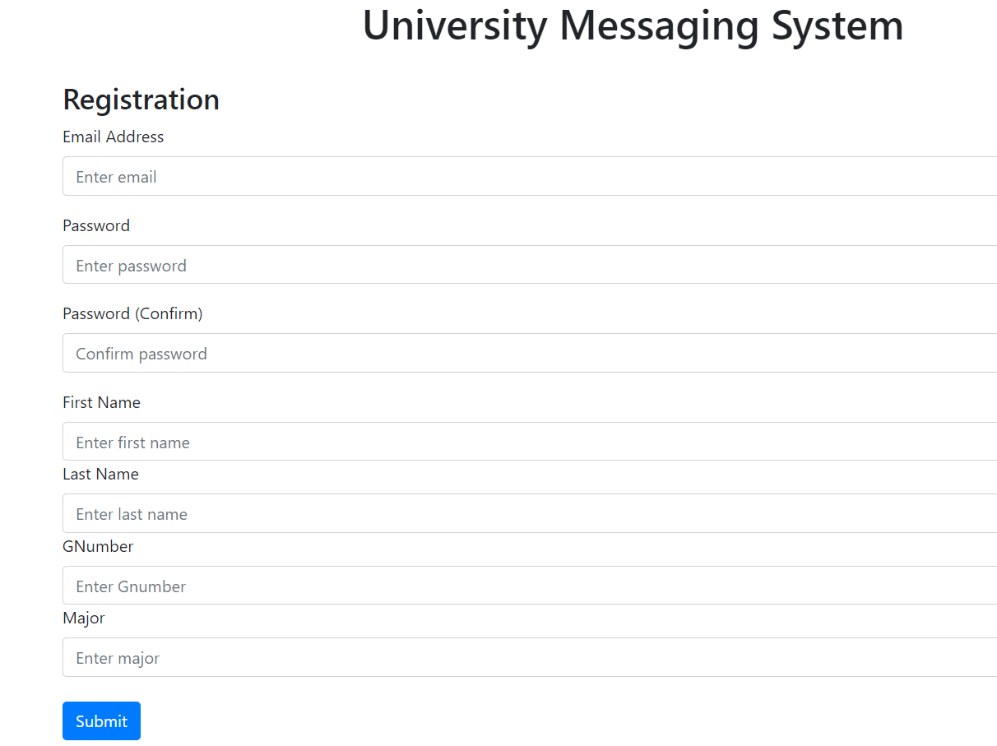
Registration screen from application

Slide 12
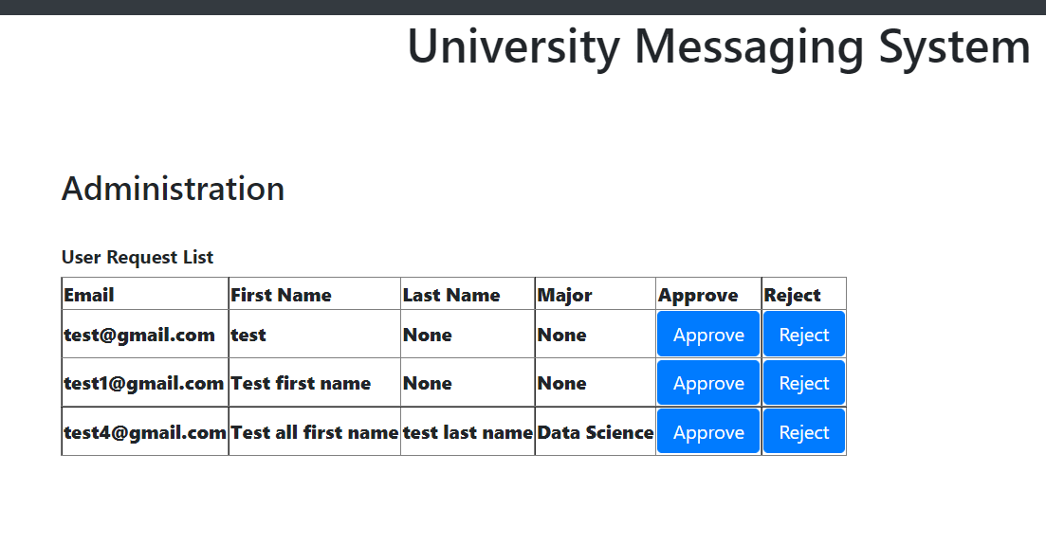
Administration screen from the application

Slide 13
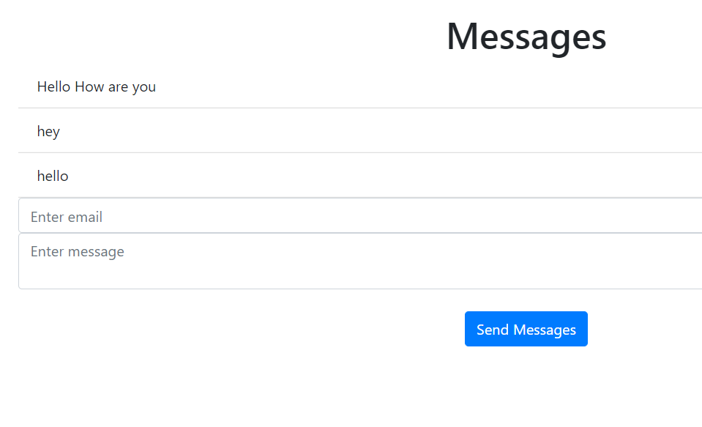
Messages Home Page

Slide 14
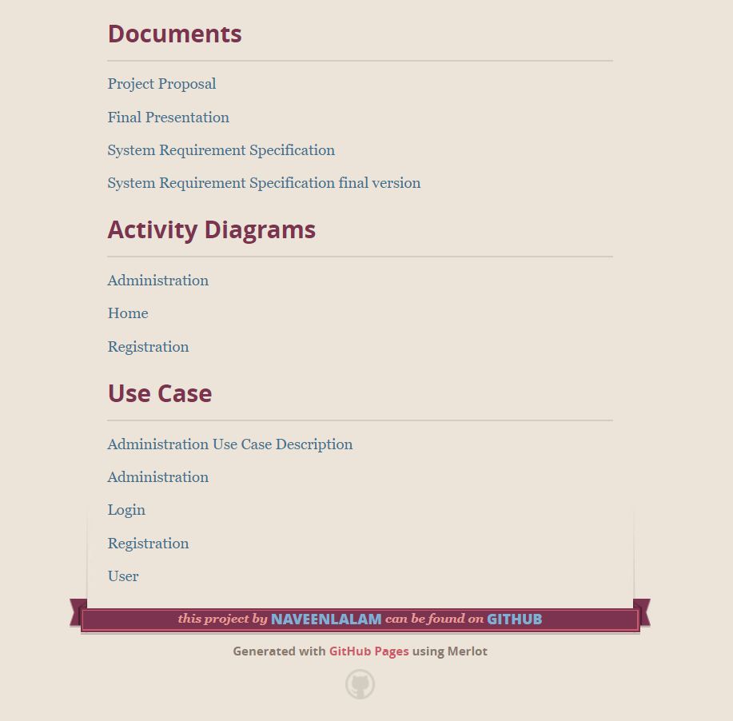
Project page
https://naveenlalam.github.io/GVSU-CIS641-Panda/
Project page is updated with the latest artifacts

Slide 15
Implementation Details
UI – html
Database – SQL lite
Technology – Python, flask framework

